Slide 1
WELCOME ADDRESS At
8TH Annual Conference On Financial CRIME, CROSS BORDER Crime & GOVERNANCE INTEGRITY
‘Tunji Aworinde
CHAIR OPEN AFRICA FOUNDATION

Slide 2

Welcome to conference

Slide 3
Welcome
CONFERENCE – DEDICATED TO PROMOTION OF THE RULE OF LAW IN NIGERIA

Slide 4
Welcome
THE HUNGER
THE POVERTY
THE INSECURITY
THE DESPAIR
ALL STEMS FROM LAWLESSNESS

Slide 5
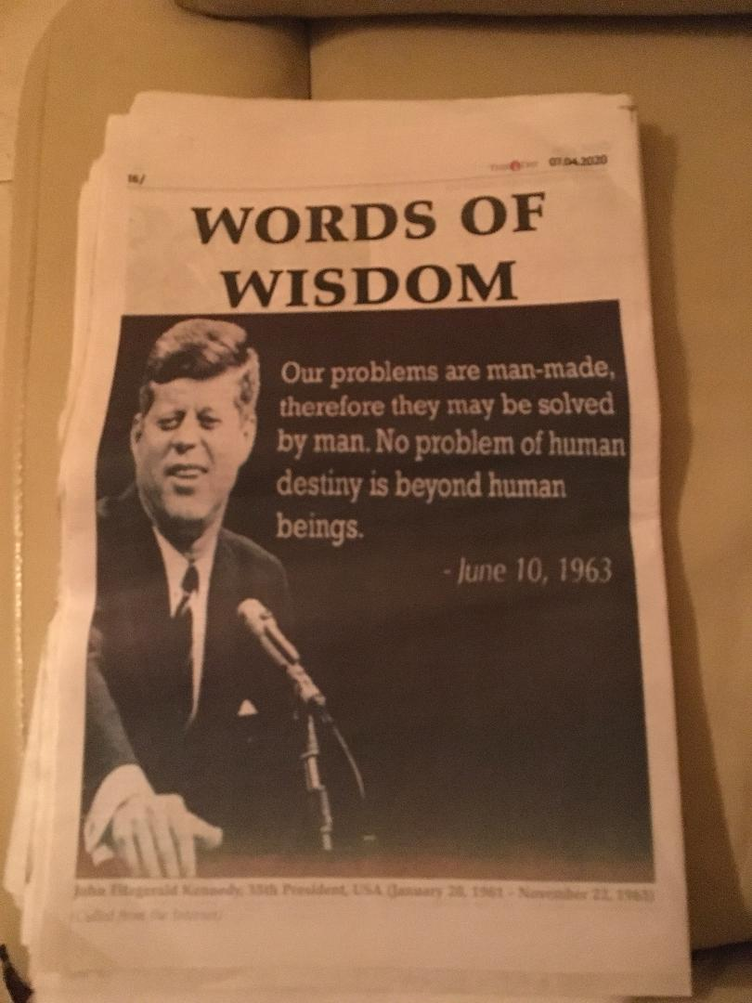
Welcome

Slide 6
Welcome
OUR CONFERENCE –
THE HUNGER
THE POVERTY
THE INSECURITY
THE DESPAIR
ARE MANMADE, AND THE SOLUTIONS LIE IN OUR HANDS

Slide 7
Welcome
OUR CONFERENCE -
CAMPAINING AGAINST FINANCIAL CRIME & FOR GOVERNANCE INTEGRITY
CAPACITY BUILDING (Next –register email)
EMPOWERMENT
FOR A NEW NIGERIA - PEACEFUL & PROSPEROUS

Slide 8

www.theforensicinsight.org

Slide 9
welcome
Our nation’s problems are man-made; therefore they may be solved by man; that no problem of human destiny is beyond humanity.

Slide 10
Welcome
Thank you for joining our campaign this week!

